Slide 1

Module:-DebitCard
Team: Investment Insiders

Slide 2
Overview
Soap :
List all cards: Displaying all the cards.
Rest:
Its divided into 3 parts
Activate
Update
Block

Slide 3
Requirement Analysis
User Authentication and Authorization
Financial Tools and Resources
Mobile Banking Support
Technologies used:
Frontend Technologies
Backend Technologies
•Security Frameworks
•DevOps Tools
•Testing Frameworks

Slide 4
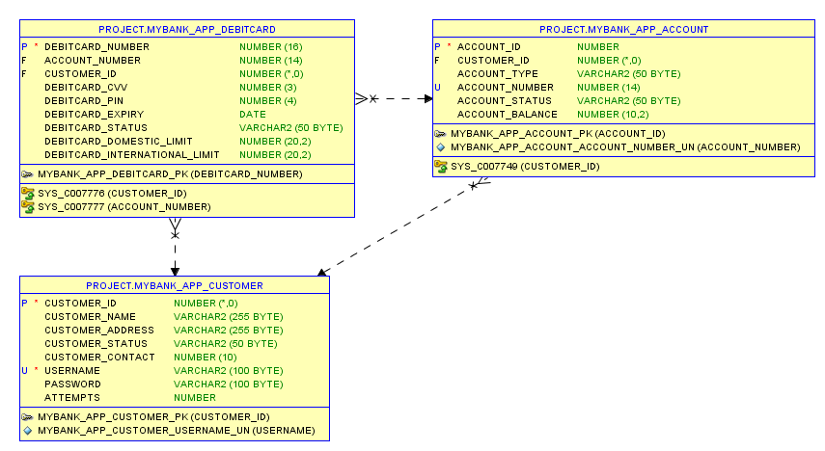
Database

Slide 5
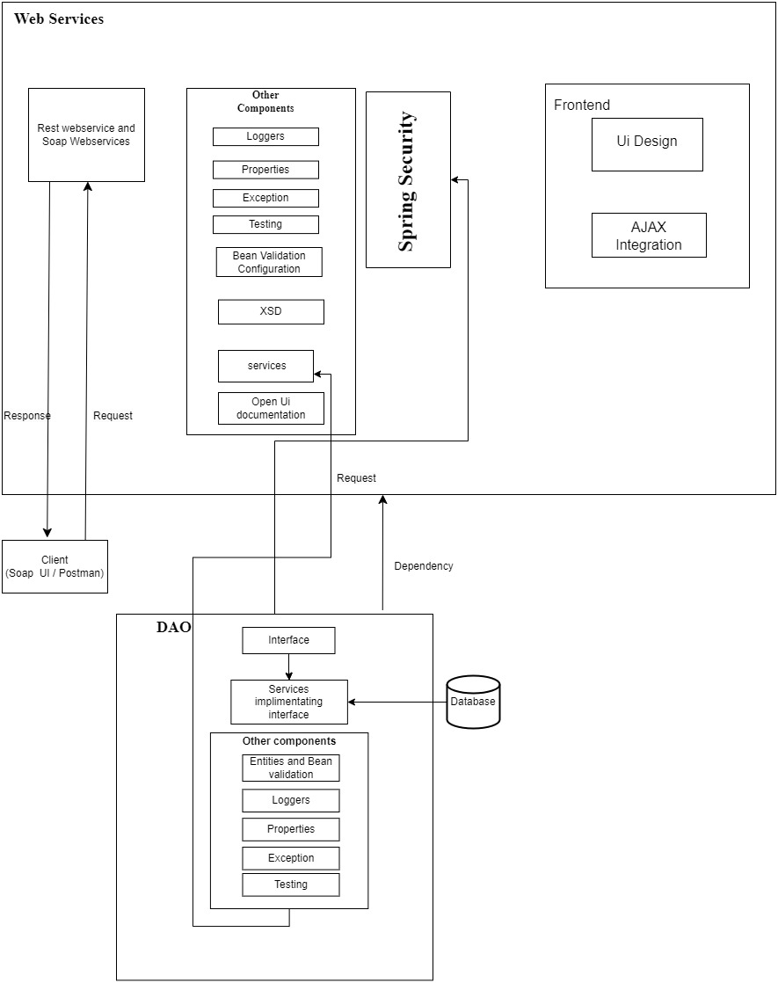
Architecture Diagram

Slide 6
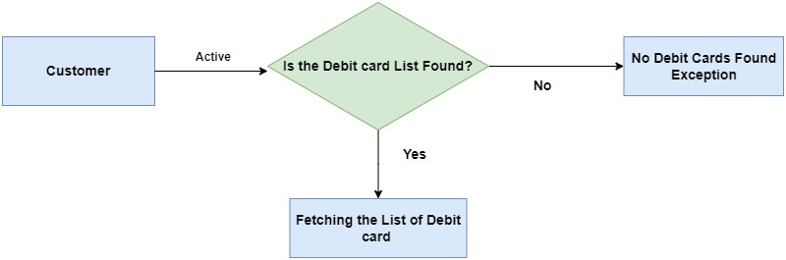
How List all works?

Slide 7
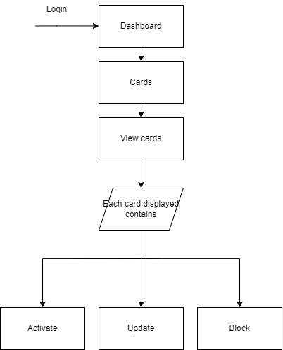
FLOW DIAGRAM

Slide 8
Jar File

Slide 9

GitHub Link
http://github.com/PRASHA02/DLTE-Java-Full-Stack-PrashanthD-2024/DLTE-MyBank-Project at master · PRASHA02/DLTE-Java-Full-Stack-PrashanthD-2024 (github.com)

Slide 10

THANK YOU

